Slide 1
Spatial Data and Python
Tim Hessels

Slide 2
Outline
Downloading data
Download Python packages
Python:
Learn to program by using:
Numpy
Pandas
Glob
GDAL
Create a Tiff image
Functions
Create monthly data based on daily data

Slide 3
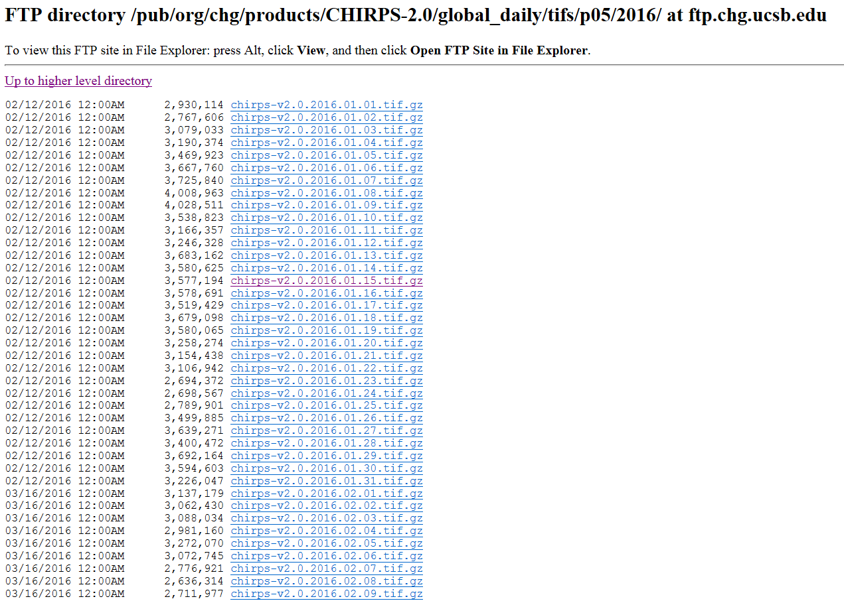
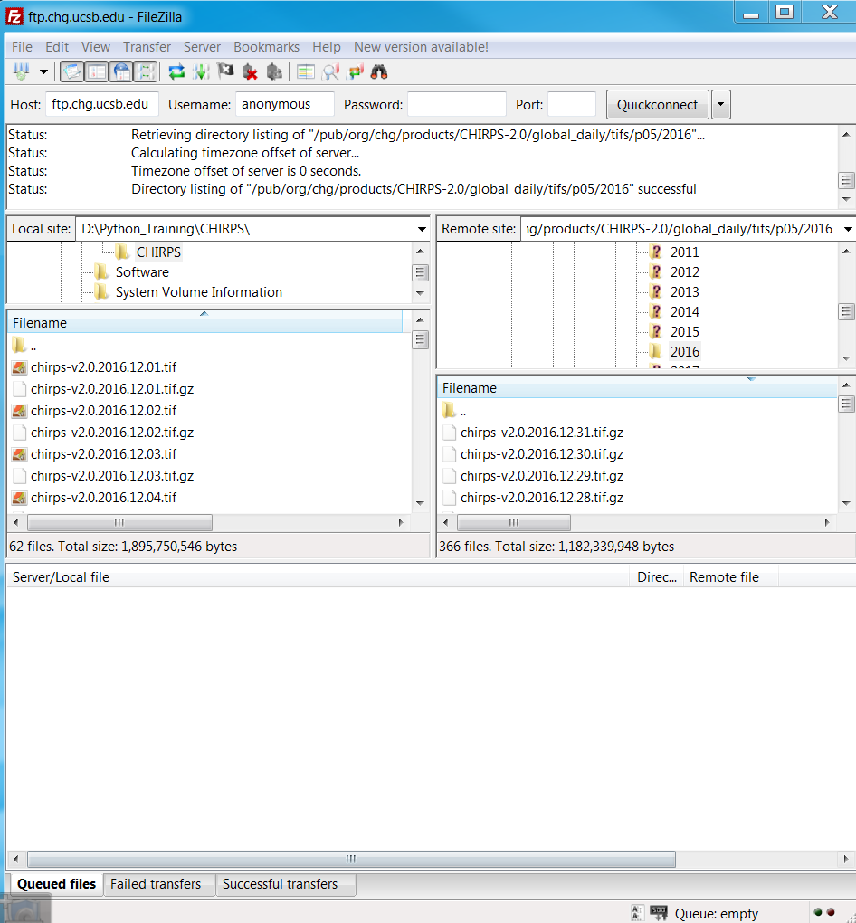
Downloading data
FileZilla link: https://filezilla-project.org/download.php
You can download a large amount of files easily by using FileZilla
This whole process can also be automated within Python, but this is out of the scope of this course

Slide 4
Downloading data
Download daily CHIRPS data of October till December 2016 by using FileZilla
Download the daily data for Africa only
/pub/org/chg/products/CHIRPS-2.0/africa_daily/tifs/p05/2016
Unzip the data

Slide 5


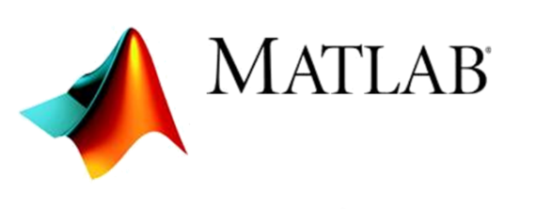
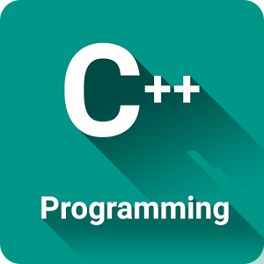

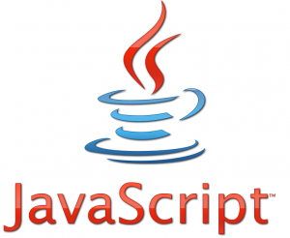

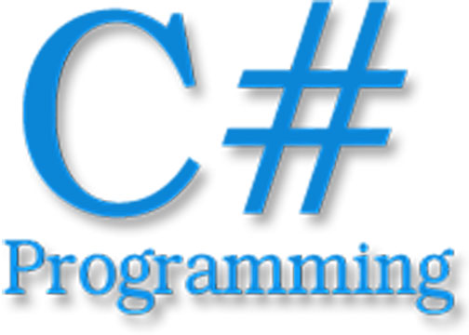
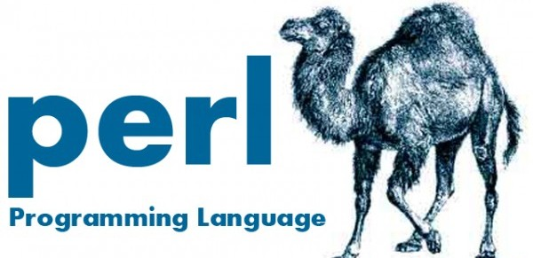
Download Python packages
Programming Languages
Why using Python?
Open access program
Widely used
A lot of tutorials on the internet

Slide 6
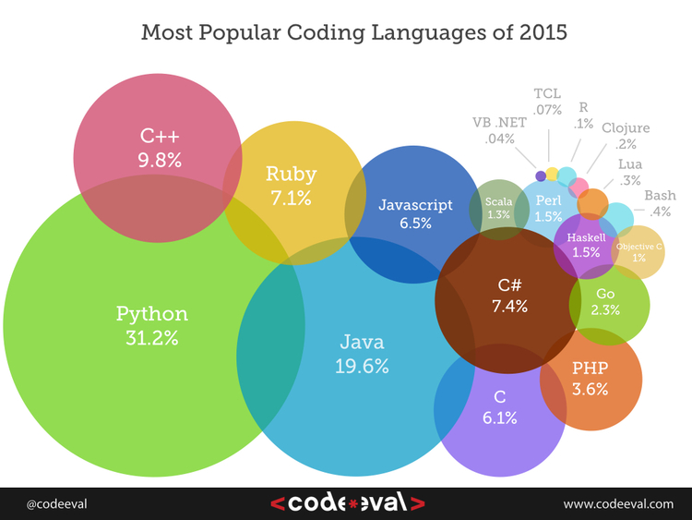
Download Python packages
Programming Languages

Slide 7





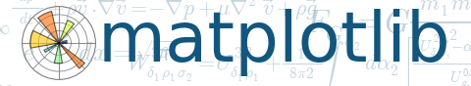


Download Python packages
Python Structure:
Programming Languages:
Graphical User Interface (GUI):
Python Modules:

Slide 8
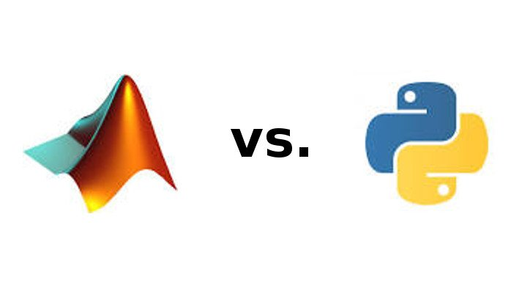
Download Python packages
Licensed
Open access
1 Developer
Many Developers (modules)
Complete Packages
Do I need to download and install all those programs and modules one by one?

Slide 9

Download Python packages
In installer
Anaconda Library
Languages:
GUI:
Modules:
Joblib
netcdf4
Full list: https://docs.continuum.io/anaconda/pkg-docs

Slide 10
Download Python packages
Which Anaconda version?
I use the 64-bits version of Python 2.7 from Anaconda:
https://www.continuum.io/downloads
How to install a packages from the Anaconda Library?
Python packages for processing geospatially data
Geospatial Data Abstraction Library (GDAL)
Library for geospatially vector and raster data formats
Is included in the Anaconda Library, so easy install is possible
Open the command prompt
Type: conda install gdal
The module will be installed

Slide 11
Python
Today
Learn to program by using:
Numpy (script 0)
Pandas (script 1)
Glob (script 2)
GDAL (script 3)
Create a Tiff image (script 4)
Functions (script 5)
Create monthly data based on daily data (script 6)

Slide 12
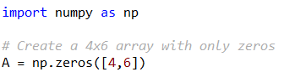
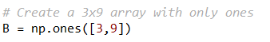
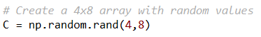
Python
Tool for Array processing
Create array with zeros only:
Create array with ones only:
Create array with random values:
Script 0

Slide 13
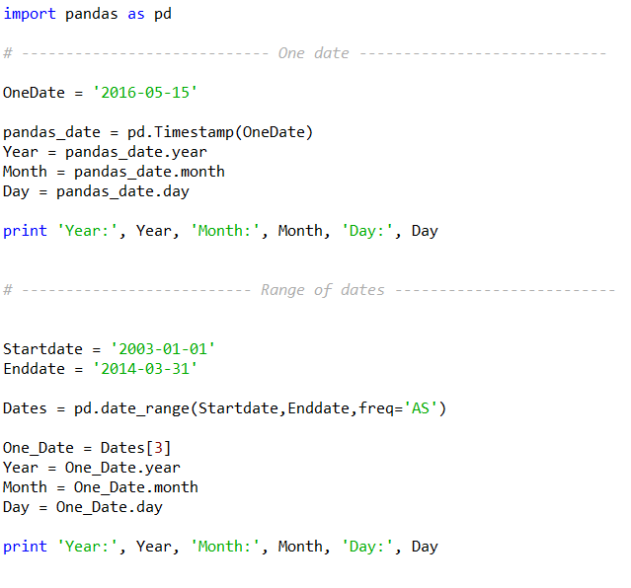
Python
Pandas:
To deal with data alignment (missing data), Reading and writing (CSV etc.),
Time series functionality:
Script 1

Slide 14
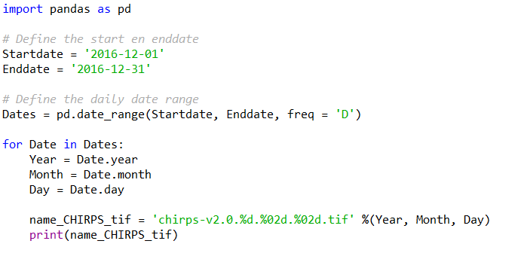
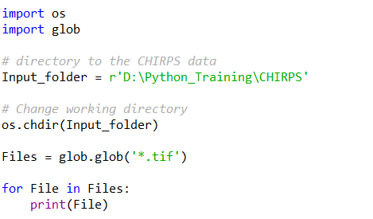
Python
Creating a variable string to define CHIRPS filenames:
Method 1 (using Pandas):
Method 2 (Using glob):
Script 2

Slide 15
Python
GTIFF = GEO Location + Array
Includes:
Projection
Geo Transform
No Data Value
Includes:
Pixel Values
Script 2

Slide 16
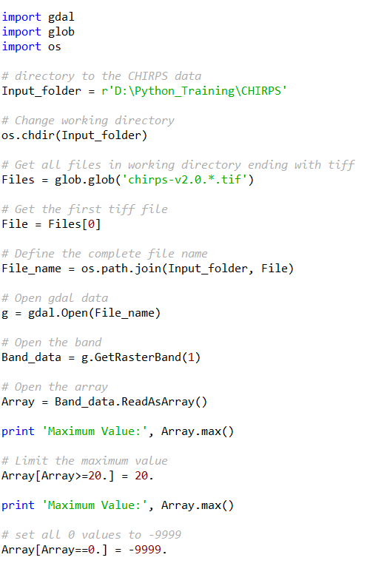
Python
Array Part:
Open Tiff data in Python and change the values of the Array
Script 3

Slide 17
Python
GTIFF = GEO Location + Array
Includes:
Projection
Geo Transform
No Data Value
Includes:
Pixel Values
Script 4

Slide 18
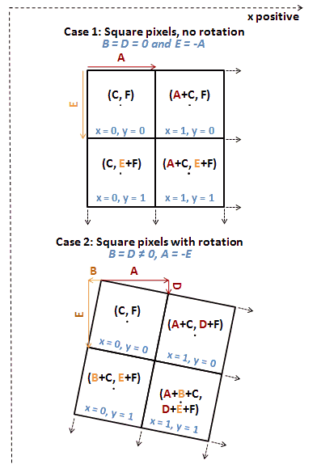
Python
To now the exact location of every point you need 6 values:
Origin X (Red point Case 1)
Origin Y (Red point Case 1)
Pixel Width (A in Case 1)
Pixel Height (W in Case 1)
Rotation in Y direction (is 0 in Case 1)
Rotation in X direction (is 0 in Case 1)
Geo Transform
Script 4

Slide 19
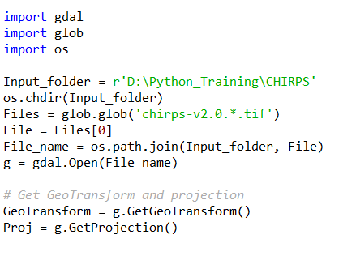
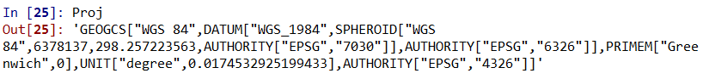
Python
Get the Geo Transform and projection
GeoTransform = (originX, pixelWidth, 0, originY, 0, pixelHeight)
Script 4

Slide 20
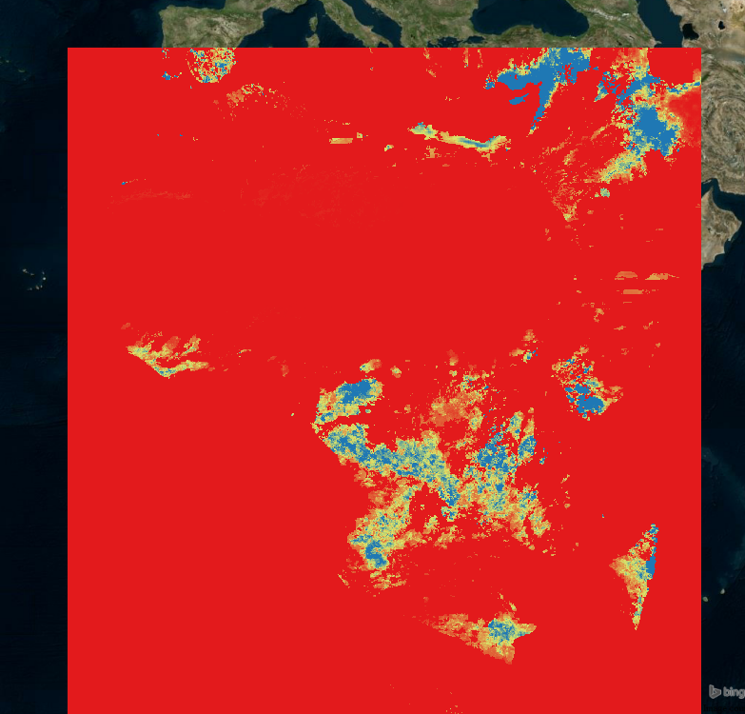
Python
Open chirps-v2.0.2016.12.01.tif in QGIS and you get:
No Data Value is not defined, this is therefore shown as a red (Value = -9999)
Now we will create a new tiff file where the no data value is defined and the pixels with 0 rainfall is also defined as no data
Script 4

Slide 21
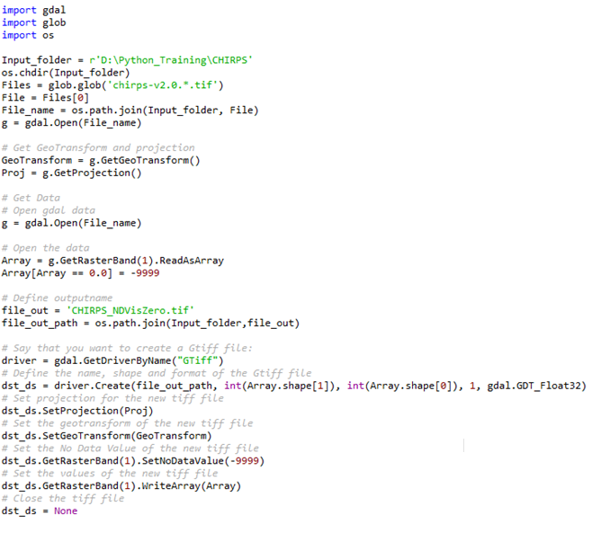
Python
Script 4

Slide 22
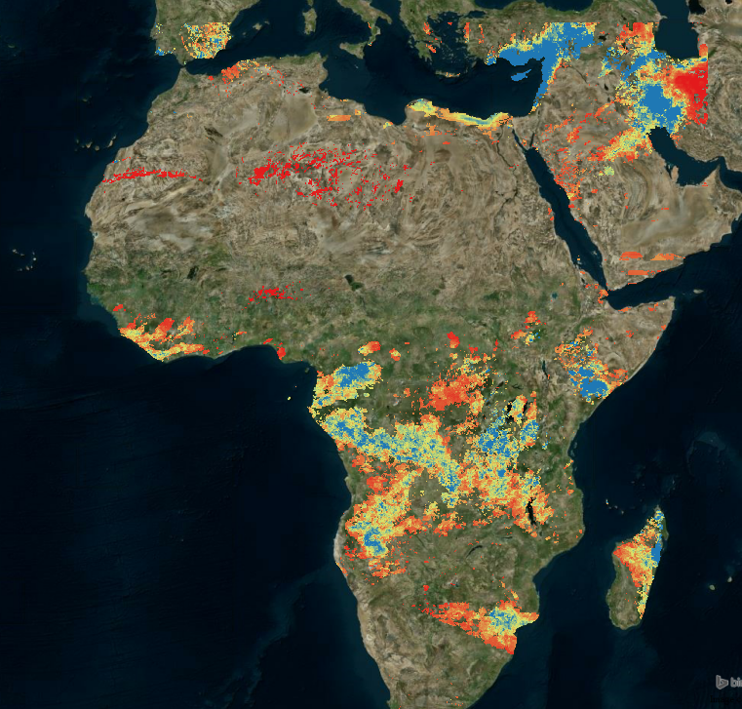
Python
Now create a new tiff file where the no data value is defined and the pixels with 0 rainfall is also defined as no data
Old Tiff
New Tiff
Script 4

Slide 23
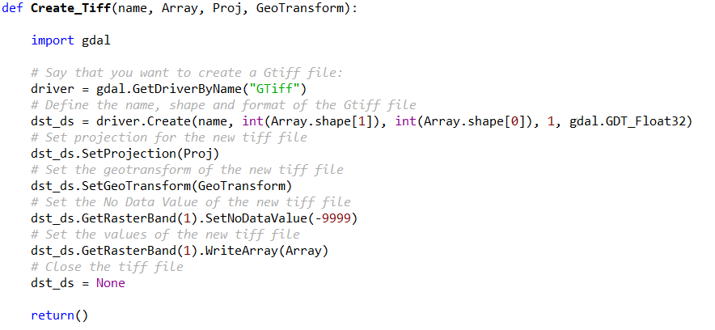
Python
Create a function if you need to apply this part of code more often
Script 5

Slide 24
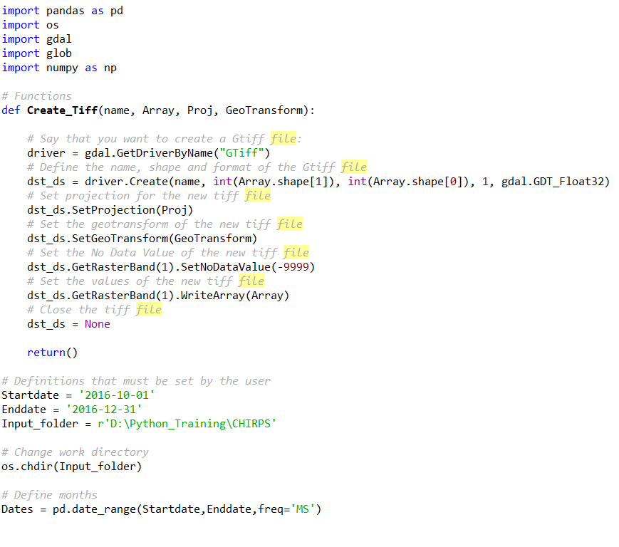
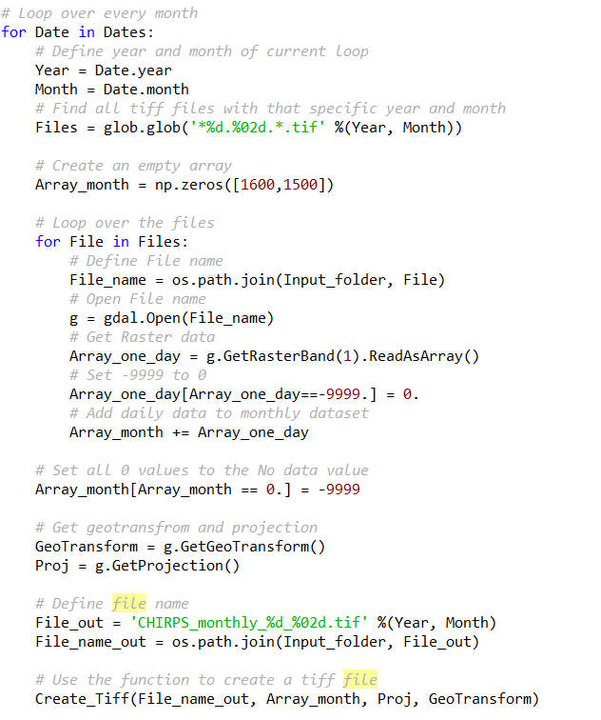
Python
Now we will merge all the functions that were explained above to sum daily data into monthly values data
Script 6

Slide 25
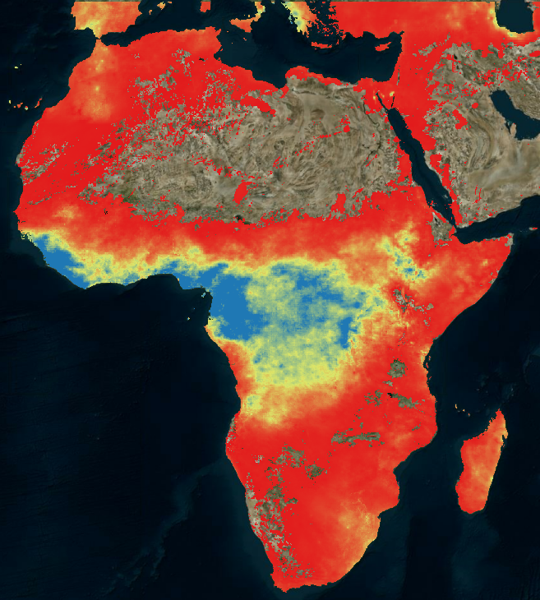
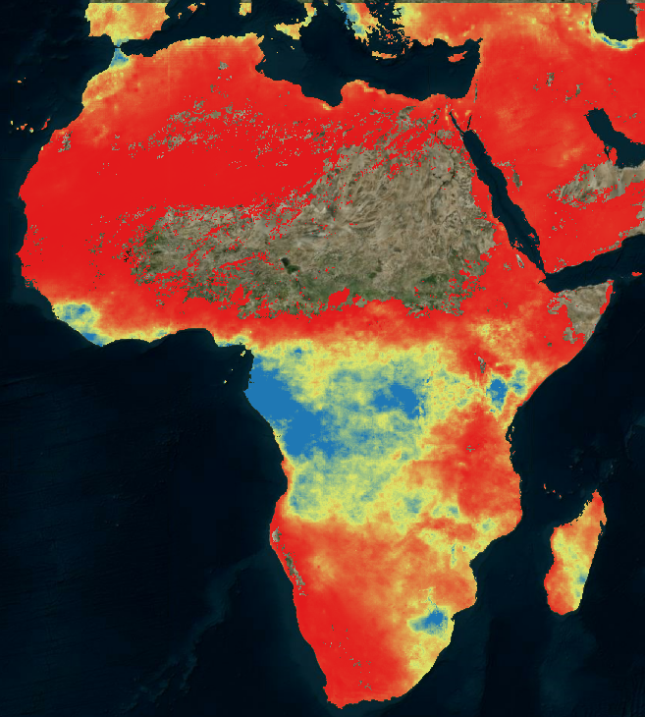
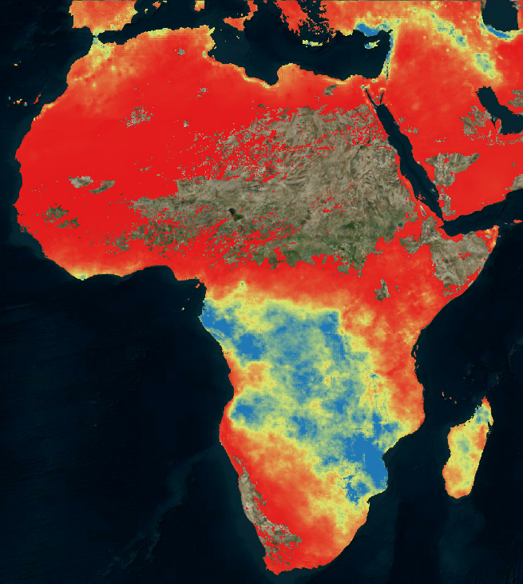
Python
October 2016
November 2016
December 2016
Script 6

